Slide 1
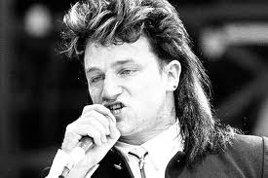
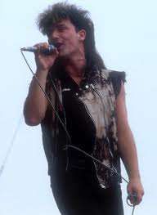
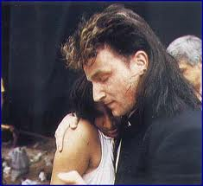
U2: “Pride (In the Name of Love)”
Music Analysis
Josh Vest Bentonville High School
joshuavest@gmail.com

Slide 2
Analysis
Student Objectives:
You will learn and practice AP style analysis through music.
Identify textual and musical features in a text.
Explain how these features create tone and/or meaning.
Support a claim with evidence from a text.
You will transfer analytical skills from text to text.
Poetry (“Facing It,” “Harlem,” and the star poems)
Nonfiction (Obasan)
Fiction (“The Pie”)
Music (“Pride”)
Visual text (“War News from Mexico”)

Slide 3
“Pride (In the Name of Love)” Agenda
Read and discuss the song’s lyrics.
Discuss textual features and identify the tone.
Listen to the song.
Complete the activity.
Discuss the activity and follow-up activities.

Slide 4
Tone
Tone- Author’s attitude towards the subject.
Identify the subject. What is Bono yelling about?
Identify his attitude towards the subject.

Slide 5
Follow-Up Activities
Write an essay.
Build skills using other music analysis activities.
Vampire Weekend’s “Ya Hey”
Simon and Garfunkel’s “I Am a Rock”
John Lennon’s “Imagine”
Have students create activities and/or presentations using their favorite songs.

