Slide 1
CIED 4023: Capstone Course for Foreign Language Licensure
Dr. Bowles
Articulation Diagram

Slide 2
Terms to Remember
Alveolar ridge
Epiglottis
Glottis
Larynx
Nasal cavity
Palate
Pharynx
Teeth
Tongue
Velum
Vocal cords

Slide 3
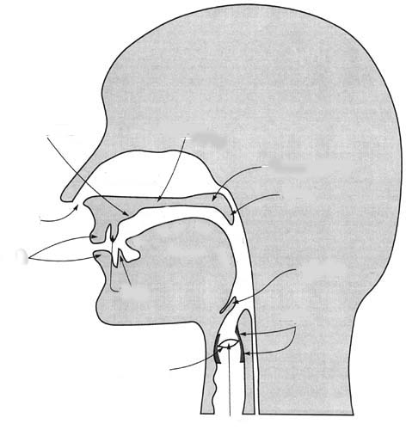
Articulation Diagram
Alveolar ridge
Palate
Velum
Uvula
Nasal cavity
Pharynx
Lips
Tongue
Epiglottis
Teeth
Larynx
Vocal Cords
Glottis

Slide 4
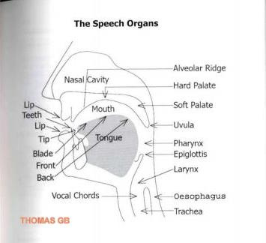
One More Look

