Slide 1
Discourse Analysis
CIED 4013

Slide 2
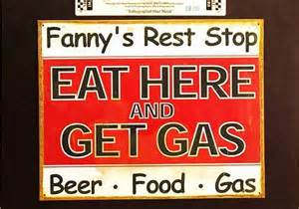
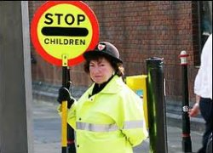
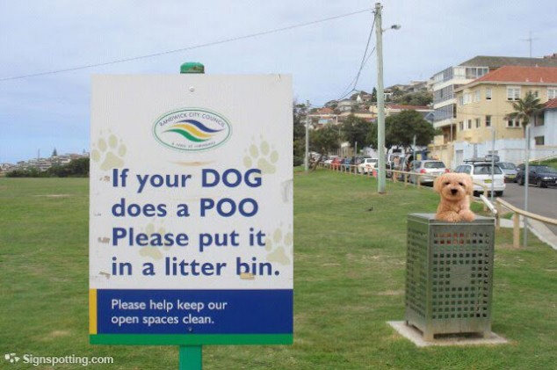
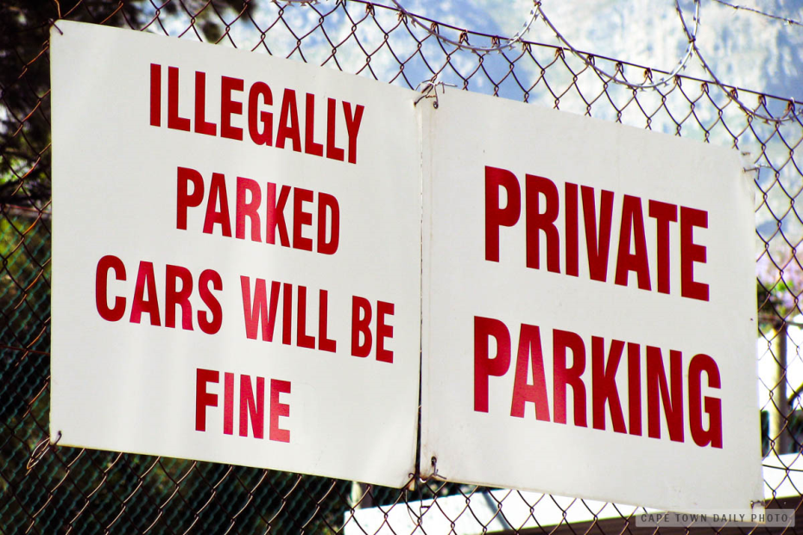
WHAT?

Slide 3
Did you really write/Say that?
For sale: R. D. Jones has one sewing machine for sale. Phone 948-0707 after 7 P.M.. and ask for Mrs. Kelly who lives with him cheap.
Entire store 25% off
"I found a smoldering cigarette left by a horse."
“I will bring my bike tomorrow if it looks nice in the morning. “
"Please wait for hostess to be seated"
“We don't just serve hamburgers, we serve people. “
Sign in a London department store: BARGAIN BASEMENT UPSTAIRS
Spotted in a safari park: ELEPHANTS PLEASE STAY IN YOUR CAR
Notice in a field: THE FARMER ALLOWS WALKERS TO CROSS THE FIELD FOR FREE, BUT THE BULL CHARGES
In an office: AFTER TEA BREAK STAFF SHOULD EMPTY THE TEAPOT AND STAND UPSIDE DOWN ON THE DRAINING BOARD
http://www.gray-area.org/Research/Ambig/

Slide 4
Discourse Analysis
Making sense of what we read and what we hear
How we interpret what others say
How we participate in conversation

Slide 5
Interpreting text
My natal was in a small town, very close to Riyadh capital of Saudi Arabia.
The distant between my and Riyadh 7 miles exactly.
The name of this Almasani that means in English Factories.
It takes this name from the peopl’s carrer.
In my childhood I remember the people live.
It was very simple.
Most the people was farmer.

Slide 6
Elements of discourse: Cohesion
My father once bought a Lincoln convertible.
He did it by saving every penny he could.
That car would b e worth a fortune nowadays.
However, he sold it to help pay for my college education.
Sometimes I think I’d rather have the convertible.
Anaphora, synonymy, transition

Slide 7
Elements of discourse: coherence
Her: That’s the telephone.
Him: I’m in the tub.
Her: O.K.
Type of event, role of speaker and hearer, their relationship, topic of conversation, setting

Slide 8
Elements of discourse: Turn-Taking
Rules for English
One person speaks at a time
Speakers avoid silence
Each person finishes with a completion signal
Each person indicates turn by using a combination of signals—short sounds, body language, phrases

Slide 9
Elements of discourse: co-operative principle
Gricean Maxims
The maxim of quantity, where one tries to be as informative as one possibly can, and gives as much information as is needed, and no more.
The maxim of quality, where one tries to be truthful, and does not give information that is false or that is not supported by evidence.
The maxim of relation, where one tries to be relevant, and says things that are pertinent to the discussion.
The maxim of manner, when one tries to be as clear, as brief, and as orderly as one can in what one says, and where one avoids obscurity and ambiguity.
http://wn.com/Gricean_maxims#/videos

Slide 10
Elements of discourse: Hedges, Implicatures, Background Knowledge, and Schema/Scripts
You are uncertain about the truth of something: As far as I know….
Something is implied in the conversation but not stated:
Ingrid: Are you coming to the party tonight?
Peter: I’ve got an exam tomorrow.
Constructing interpretations of conversation / text based on our expectations of what normally happens.
Using conventional knowledge structures that exist in our memory

